Slide 1


Selection Trees
Winner trees.
Loser Trees.
Notes:
Tennis ladder.

Slide 2
Winner Trees
Complete binary tree with n external nodes and n - 1 internal nodes.
External nodes represent tournament players.
Each internal node represents a match played between its two children; the winner of the match is stored at the internal node.
Root has overall winner.

Slide 3
Winner Tree for 16 Players
player
match node
Notes:
See text for case when number of players is not a power of 2.

Slide 4
Winner Tree for 16 Players
1
1
2
3
1
2
2
3
6
1
3
2
4
2
5
4
3
6
8
1
5
7
3
2
6
9
4
5
2
5
8
Smaller element wins => min winner tree.

Slide 5
Winner Tree for 16 Players
1
1
2
3
1
2
2
3
6
1
3
2
4
2
5
4
3
6
8
1
5
7
3
2
6
9
4
5
2
5
8
height is log₂ n (excludes player level)

Slide 6
Complexity of Initialize
O(1) time to play match at each match node.
n - 1 match nodes.
O(n) time to initialize n player winner tree.

Slide 7
Applications
Sorting.
Insert elements to be sorted into a winner tree.
Repeatedly extract the winner and replace by a large value.

Slide 8
Sort 16 Numbers
1
1
2
3
1
2
2
3
6
1
3
2
4
2
5
4
3
6
8
1
5
7
3
2
6
9
4
5
2
5
8

Slide 9
Sort 16 Numbers
1
1
2
3
1
2
2
3
6
1
3
2
4
2
5
4
3
6
8
1
5
7
3
2
6
9
4
5
2
5
8

Slide 10
Sort 16 Numbers
1
1
2
3
1
2
2
3
6
1
3
2
4
2
5
4
3
6
8
1
5
7
3
2
6
9
4
5
2
5
8
1
Sorted array.

Slide 11
Sort 16 Numbers
1
1
2
3
1
2
2
3
6
5
3
2
4
2
5
4
3
6
8
1
5
7
3
2
6
9
4
5
2
5
8
1
Sorted array.

Slide 12
Sort 16 Numbers
1
1
2
3
3
2
2
3
6
5
3
2
4
2
5
4
3
6
8
1
5
7
3
2
6
9
4
5
2
5
8
1
Sorted array.

Slide 13
Sort 16 Numbers
1
3
2
3
3
2
2
3
6
5
3
2
4
2
5
4
3
6
8
1
5
7
3
2
6
9
4
5
2
5
8
1
Sorted array.

Slide 14
Sort 16 Numbers
2
3
2
3
3
2
2
3
6
5
3
2
4
2
5
4
3
6
8
1
5
7
3
2
6
9
4
5
2
5
8
1
Sorted array.

Slide 15
Sort 16 Numbers
2
3
2
3
3
2
2
3
6
5
3
2
4
2
5
4
3
6
8
1
5
7
3
2
6
9
4
5
2
5
8
1
2
2
2
Sorted array.

Slide 16
Sort 16 Numbers
2
3
2
3
3
2
2
3
6
5
3
6
4
2
5
4
3
6
8
1
5
7
3
2
6
9
4
5
2
5
8
1
2
2
2
Sorted array.

Slide 17
Sort 16 Numbers
2
3
2
3
3
4
2
3
6
5
3
6
4
2
5
4
3
6
8
1
5
7
3
2
6
9
4
5
2
5
8
1
2
2
2
Sorted array.

Slide 18
Sort 16 Numbers
2
3
2
3
3
4
2
3
6
5
3
6
4
2
5
4
3
6
8
1
5
7
3
2
6
9
4
5
2
5
8
1
2
2
2
Sorted array.

Slide 19
Sort 16 Numbers
2
3
2
3
3
4
2
3
6
5
3
6
4
2
5
4
3
6
8
1
5
7
3
2
6
9
4
5
2
5
8
1
2
2
2
Sorted array.

Slide 20
Sort 16 Numbers
2
3
2
3
3
4
2
3
6
5
3
6
4
2
5
4
3
6
8
1
5
7
3
2
6
9
4
5
2
5
8
1
2
2
Sorted array.

Slide 21
Sort 16 Numbers
2
3
2
3
3
4
2
3
6
5
3
6
4
5
5
4
3
6
8
1
5
7
3
2
6
9
4
5
2
5
8
1
2
2
Sorted array.

Slide 22
Sort 16 Numbers
2
3
2
3
3
4
5
3
6
5
3
6
4
5
5
4
3
6
8
1
5
7
3
2
6
9
4
5
2
5
8
1
2
2
Sorted array.

Slide 23
Sort 16 Numbers
2
3
4
3
3
4
5
3
6
5
3
6
4
5
5
4
3
6
8
1
5
7
3
2
6
9
4
5
2
5
8
1
2
2
Sorted array.

Slide 24
Sort 16 Numbers
3
3
4
3
3
4
5
3
6
5
3
6
4
5
5
4
3
6
8
1
5
7
3
2
6
9
4
5
2
5
8
1
2
2
Sorted array.

Slide 25
Sort 16 Numbers
3
3
4
3
3
4
5
3
6
5
3
6
4
5
5
4
3
6
8
1
5
7
3
2
6
9
4
5
2
5
8
1
2
2
3
Sorted array.

Slide 26

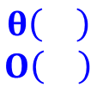
Time to Sort
Initialize winner tree.
  O(n) time
Remove winner and replay.
  O(log n) time
Remove winner and replay n times.
  O(n log n) time
Total sort time is O(n log n).
Actually Theta(n log n).
每次執行時間都是n log n
(vs 每次執行時間不超過n log n)

Slide 27
Winner Tree Operations
Initialize
  O(n) time
Get winner
  O(1) time
Remove/replace winner and replay
  O(log n) time
  more precisely Theta(log n)

Slide 28
Replace Winner and Replay
1
1
2
3
1
2
2
3
6
1
3
2
4
2
5
4
3
6
8
1
5
7
3
2
6
9
4
5
2
5
8
Replace winner with 6.

Slide 29
Replace Winner and Replay
1
1
2
3
1
2
2
3
6
1
3
2
4
2
5
4
3
6
8
6
5
7
3
2
6
9
4
5
2
5
8
Replay matches on path to root.

Slide 30
Replace Winner and Replay
1
1
2
3
1
2
2
3
6
1
3
2
4
2
5
4
3
6
8
6
5
7
3
2
6
9
4
5
2
5
8
Replay matches on path to root.

Slide 31
Replace Winner and Replay
1
1
2
3
1
2
2
3
6
1
3
2
4
2
5
4
3
6
8
6
5
7
3
2
6
9
4
5
2
5
8
Opponent is player who lost last match played at this node.

Slide 32
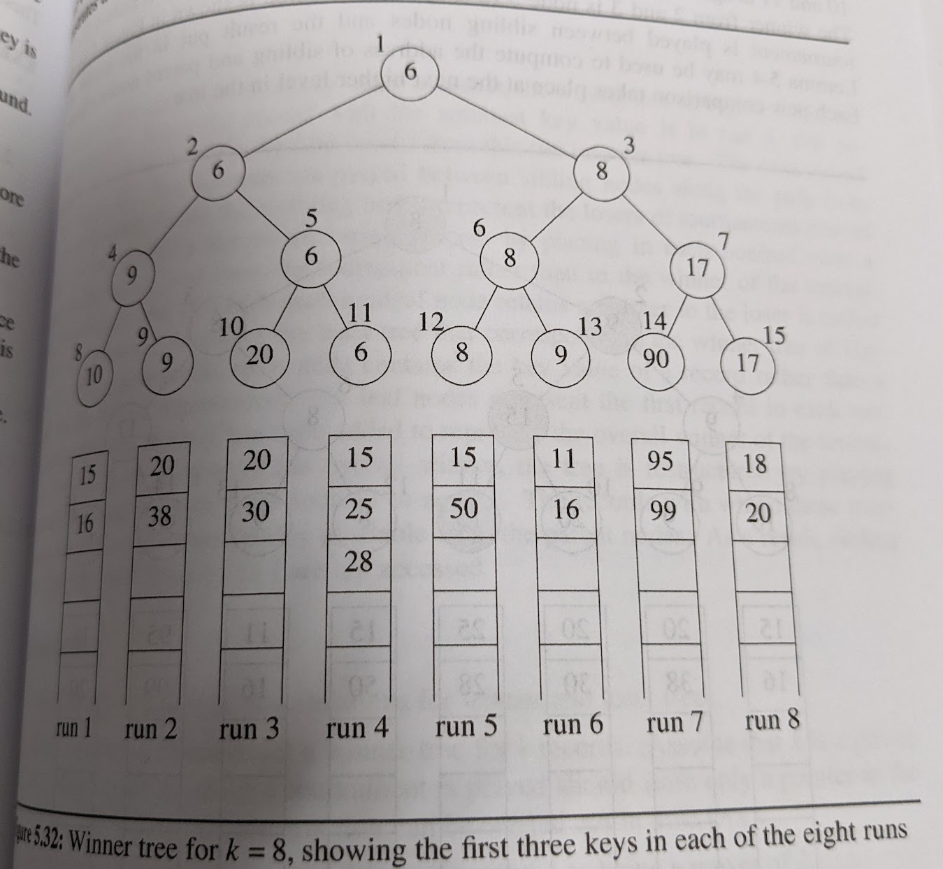


Slide 33
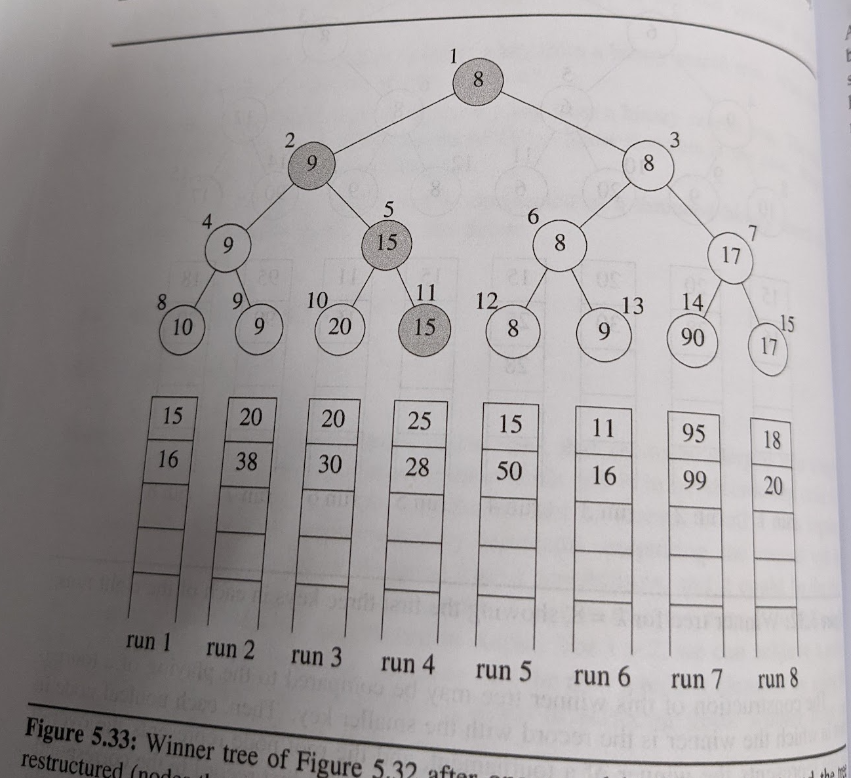

Slide 34
Loser Tree
Each match node stores the match loser rather than the match winner.
還有，請仔細聽…

Slide 35
Min Loser Tree for 16 Players
3
4
8
4
3
6
8
1
5
7
3
2
6
9
4
5
2
5
8

Slide 36
Min Loser Tree for 16 Players
3
6
1
4
8
5
7
4
3
6
8
1
5
7
3
2
6
9
4
5
2
5
8

Slide 37
Min Loser Tree for 16 Players
1
3
6
3
2
4
8
5
7
6
9
4
3
6
8
1
5
7
3
2
6
9
4
5
2
5
8

Slide 38
Min Loser Tree for 16 Players
1
3
2
6
3
4
2
4
8
5
7
6
9
5
8
4
3
6
8
1
5
7
3
2
6
9
4
5
2
5
8

Slide 39
Min Loser Tree for 16 Players
1
3
2
6
3
4
5
4
8
5
7
6
9
5
8
4
3
6
8
1
5
7
3
2
6
9
4
5
2
5
8

Slide 40
Min Loser Tree for 16 Players
1
3
2
6
3
4
5
4
8
5
7
6
9
5
8
4
3
6
8
1
5
7
3
2
6
9
4
5
2
5
8

Slide 41
Min Loser Tree for 16 Players
2
3
2
6
3
4
5
4
8
5
7
6
9
5
8
4
3
6
8
1
5
7
3
2
6
9
4
5
2
5
8

Slide 42
Winner
1
2
3
2
6
3
4
5
4
8
5
7
6
9
5
8
4
3
6
8
1
5
7
3
2
6
9
4
5
2
5
8

Slide 43
Complexity of Loser Tree Initialize
One match at each match node.
One store of a left child winner.
Total time is O(n).
More precisely Theta(n).

Slide 44
Winner
1
2
2
3
3
3
2
6
3
4
5
5
4
8
5
7
6
9
5
8
9
4
3
6
8
9
1
5
7
3
2
6
9
4
5
2
5
8
Replace winner with 9 and replay matches.

Slide 45
Complexity of Replay
One match at each level that has a match node.
O(log n)
More precisely Theta(log n).

Slide 46
More Selection Tree Applications
k-way merging of runs during an external merge sort
Truck loading

Slide 47

Truck Loading
  n packages to be loaded into trucks
  each package has a weight
  each truck has a capacity of c tons
  minimize number of trucks
Notes:
Distribution center in Jacksonville sends packages to distribution center in Miami. Use the fewest number of trucks.

Slide 48
Truck Loading
n = 5 packages
weights [2, 5, 6, 3, 4]
truck capacity c = 10
Load packages from left to right. If a package doesn’t fit into current truck, start loading a new truck.

Slide 49
Truck Loading
n = 5 packages
weights [2, 5, 6, 3, 4]
truck capacity c = 10
truck1 = [2, 5]
truck2 = [6, 3]
truck3 = [4]
uses 3 trucks when 2 trucks suffice

Slide 50
Truck Loading
n = 5 packages
weights [2, 5, 6, 3, 4]
truck capacity c = 10
truck1 = [2, 5, 3]
truck2 = [6, 4]

Slide 51
Bin Packing
  n items to be packed into bins
  each item has a size
  each bin has a capacity of c
  minimize number of bins

Slide 52
Bin Packing
Truck loading is same as bin packing.
  Truck is a bin that is to be packed (loaded).
  Package is an item/element.
Bin packing to minimize number of bins is NP-hard.
Several fast heuristics have been proposed.

Slide 53
Bin Packing Heuristics
First Fit.
  Bins are arranged in left to right order.
  Items are packed one at a time in given order.
  Current item is packed into leftmost bin into which it fits.
  If there is no bin into which current item fits, start a new bin.

Slide 54
First Fit
n = 4
weights = [4, 7, 3, 6]
capacity = 10
Pack red item into first bin.

Slide 55
First Fit
n = 4
weights = [4, 7, 3, 6]
capacity = 10
Pack blue item next.
Doesn’t fit, so start a new bin.

Slide 56
First Fit
n = 4
weights = [4, 7, 3, 6]
capacity = 10

Slide 57
First Fit
n = 4
weights = [4, 7, 3, 6]
capacity = 10
Pack yellow item into first bin.

Slide 58
First Fit
n = 4
weights = [4, 7, 3, 6]
capacity = 10
Pack green item.
Need a new bin.

Slide 59
First Fit
n = 4
weights = [4, 7, 3, 6]
capacity = 10
Not optimal.
2 bins suffice.

Slide 60
Bin Packing Heuristics
First Fit Decreasing.
  Items are sorted into decreasing order.
  Then first fit is applied.

Slide 61
Bin Packing Heuristics
Best Fit.
  Items are packed one at a time in given order.
  To determine the bin for an item, first determine set S of bins into which the item fits.
  If S is empty, then start a new bin and put item into this new bin.
  Otherwise, pack into bin of S that has least available capacity.

Slide 62
Bin Packing Heuristics
Best Fit Decreasing.
  Items are sorted into decreasing order.
  Then best fit is applied.

Slide 63
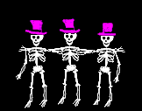
Performance
For first fit and best fit:
  Heuristic Bins <= approx. ratio = (17/10)(Minimum Bins) + 2
For first fit decreasing and best fit decreasing:
  Heuristic Bins <= approx. ratio = (11/9)(Minimum Bins) + 4
繼續追求更好的演算法?
堪用就好或追求完美？

Slide 64
Complexity of Best Fit Decreasing
Use a max tournament tree (winner tree) in which the players are n bins and the value of a player is the available capacity in the bin.
O(n log n), where n is the number of items.

